Slide 1


Future ATM
Civil Aviation University of China
Civil Aviation University of China
ICAO Global ATM Operational Concept
SESAR
NEXTGEN
ICAO Aviation System Block Upgrades

Slide 2
ICAO Global ATM Operational Concept
Complex Interaction
AOM
DCB
AO
TS
CM
AUO
ATM SDM
Information Management
Seven Components of the ICAO Global ATM Operational Concept
AOM— Airspace organization and management DCB— Demand/capacity balancing
AO— Aerodrome operations TS— Traffic synchronization
CM— Conflict management AUO— Airspace user operations
ATM SDM — ATM service delivery management

Slide 3
Airspace organization and management
Airspace organization will establish airspace structures in order to accommodate the different types of air activity, volume of traffic and differing levels of service. Airspace management is the process by which airspace options are selected and applied to meet the needs of the ATM community. Key conceptual changes include:
all airspace will be the concern of ATM and will be a usable resource;
airspace management will be dynamic and flexible;
any restriction on the use of any particular volume of airspace will be considered transitory; and
all airspace will be managed flexibly. Airspace boundaries will be adjusted to particular traffic flows and should not be constrained by national or facility boundaries.

Slide 4
Aerodrome operations
As an integral part of the ATM system, the aerodrome operator must provide the needed ground infrastructure including, inter alia, lighting, taxiways, runways, including exits, and precise surface guidance to improve safety and maximize aerodrome capacity in all weather conditions. The ATM system will enable the efficient use of the capacity of the aerodrome airside infrastructure. Key conceptual changes include:
runway occupancy time will be reduced;
the capability will exist to safely manoeuvre in all weather conditions while maintaining capacity;
precise surface guidance to and from a runway will be required in all conditions; and
the position (to an appropriate level of accuracy) and intent of all vehicles and aircraft operating on the movement area will be known and available to the appropriate ATM community members.

Slide 5
Demand and capacity balancing
Demand and capacity balancing will strategically evaluate system-wide traffic flows and aerodrome capacities to allow airspace users to determine when, where and how they operate, while mitigating conflicting needs for airspace and aerodrome capacity. This collaborative process will allow for the efficient management of the air traffic flow through the use of information on system-wide air traffic flows, weather and assets. Key conceptual changes include:
through collaborative decision making at the strategic stage, assets will be optimized in order to maximize throughput, thus providing a basis for predictable allocation and scheduling;
through collaborative decision making at the pre-tactical stage, when possible, adjustments will be made to assets, resource allocations, projected trajectories, airspace organization, and allocation of entry/exit times for aerodromes and airspace volumes to mitigate any imbalance; and
at the tactical stage, actions will include dynamic adjustments to the organization of airspace to balance capacity, dynamic changes to the entry/exit times for aerodromes and airspace volumes, and adjustments to the schedule by the users.

Slide 6
Traffic synchronization
Traffic synchronization refers to the tactical establishment and maintenance of a safe, orderly and efficient flow of air traffic. Key conceptual changes include:
there will be dynamic four-dimensional (4-D) trajectory control and negotiated conflict-free trajectories;
choke points will be eliminated; and
optimization of traffic sequencing will achieve maximization of runway throughput.

Slide 7
Airspace user operations
Airspace user operations refer to the ATM-related aspect of flight operations. Key conceptual changes include:
the accommodation of mixed capabilities and worldwide implementation needs will be addressed to enhance safety and efficiency;
relevant ATM data will be fused for an airspace user’s general, tactical and strategic situational awareness and conflict management;
relevant airspace user operational information will be made available to the ATM system;
individual aircraft performance, flight conditions, and available ATM resources will allow dynamically-optimized 4-D trajectory planning;
collaborative decision making will ensure that aircraft and airspace user system design impacts on ATM are taken into account in a timely manner; and
aircraft should be designed with the ATM system as a key consideration

Slide 8
Conflict management
Conflict management will consist of three layers: strategic conflict management through airspace organization and management, demand and capacity balancing, and traffic synchronization; separation provision; and collision avoidance. Conflict management will limit, to an acceptable level, the risk of collision between aircraft and hazards. Hazards that an aircraft will be separated from are: other aircraft, terrain, weather, wake turbulence, incompatible airspace activity and, when the aircraft is on the ground, surface vehicles and other obstructions on the apron and manoeuvring area. Key conceptual changes include:
strategic conflict management will reduce the need for separation provision to a designated level;

Slide 9
Conflict management
(continued)
the ATM system will minimize restrictions on user operations; therefore, the predetermined separator will be the airspace user, unless safety or ATM system design requires a separation provision service;
the role of separator may be delegated, but such delegations will be temporary;
in the development of separation modes, separation provision intervention capability must be considered;
the conflict horizon will be extended as far as procedures and information will permit; and
collision avoidance systems will be part of ATM safety management but will not be included in determining the calculated level of safety required for separation provision.

Slide 10
ATM service delivery management
ATM service delivery management will operate seamlessly from gate to gate for all phases of flight and across all service providers. The ATM service delivery management component will address the balance and consolidation of the decisions of the various other processes/services, as well as the time horizon at which, and the conditions under which, these decisions are made. Flight trajectories, intent and agreements will be important components to delivering a balance of decisions. Key conceptual changes include:
services to be delivered by the ATM service delivery management component will be established on an as-required basis subject to ATM system design. Once established, they will be provided on an on-request basis;

Slide 11
ATM service delivery management
(continued)
ATM system design will be determined by collaborative decision making and system-wide safety and business cases;
services delivered by the ATM service delivery management component will, through collaborative decision making, balance and optimize user-requested trajectories to achieve the ATM community’s expectations; and
management by trajectory will involve the development of an agreement that extends through all the physical phases of the flight.

Slide 12
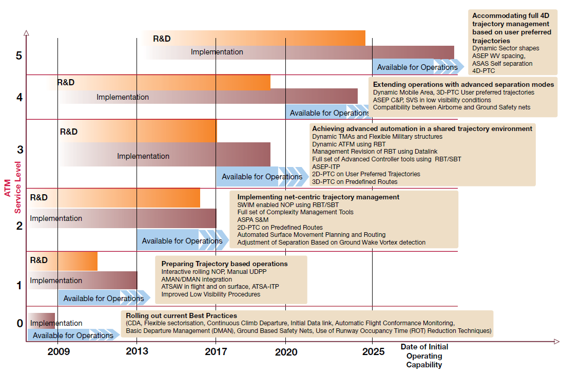
SESAR
Notes:
UDPP- User Driven Prioritisation Process (ATSAW)- Airborne Traffic Situation Awareness
(ATSA-ITP)- Airborne Traffic Situation Awareness In Trail Procedure RBT- Reference Business Trajectory SBT - Shared Business Trajectory
(ASPA-S&M)- Airborne Spacing - Sequencing and Merging ASAS - Airborne Separation Assistance System
PTC - Precision Trajectory Clearances C&P – Crossing & Passing
ASEP - ASAS (Airborne Separation Assistance) System Separation SV/SVS - Synthetic Vision/ SV System
WV - Wake Vortex NOP – Network Operation Plan

Slide 13
SESAR Concept of Operations
SWIM
The SWIM network will be an IP based data transport network, using proven information communication technology. It will replace the current point to point data systems with a ground/ground communications network which connects all ATM partners; ANSPs, airports and airspace users, including the military. Aircraft will become travelling nodes in the network, permanently connected by a new high capacity air/ground data link.
Using the SWIM network, all partners (in the air and on the ground) will become both consumers and producers of information, which they will share, tailored to their individual needs. This will allow them to make decisions based on full knowledge of accurate up-to-date information and to put back into the system the results of their decisions for others to use.

Slide 14
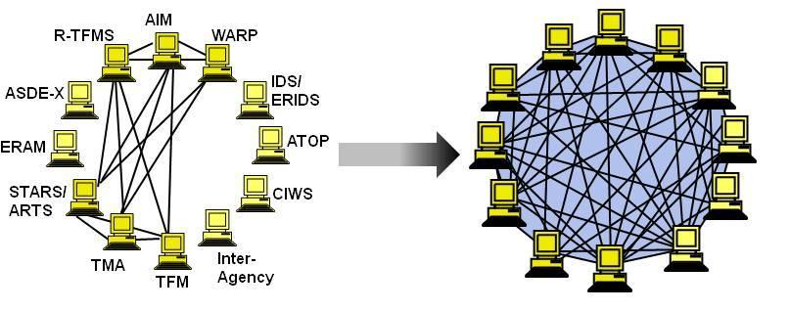
SESAR Concept of Operations-CDM
The airspace users start by defining and then sharing, with ATM partners, their business/mission intentions. These trajectories are then modified as necessary using a layered CDM planning process which takes account of identified constraints.
The ATM planning process is one of continuous refinement as better data becomes available. There is no clearly defined starting point to the process, it starts many years before the day of operation, taking into account such considerations as staff recruitment, training plans and major system procurements. The goal of collaborative layered planning is to balance ATM resources and airspace user demand. In the months leading up to the initiation of the flight the iterative planning process refines the trajectories and the available resources and expresses these as the Network Operations Plan (NOP).

Slide 15
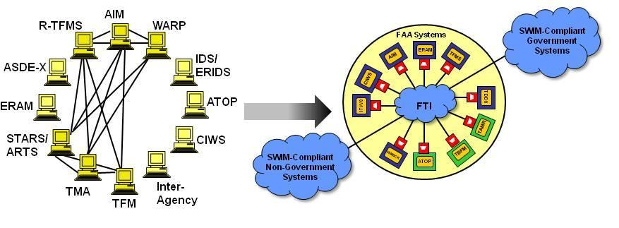
SESAR Concept of Operations-CDM
The NOP is a rolling plan giving a snapshot of the network at any one time. The aim of the NOP is to facilitate the processes needed to reach agreements on demand and capacity. This planning is overseen by a Network Management function which assures, at both network and regional level, the stability and efficiency of the ATM network.
The final trajectory just before flight execution is called the Reference Business Trajectory (RBT). Depending on the ATM Capability Level, it is expressed in up to 4 dimensions, and is the trajectory which the airspace user agrees to fly and the ANSP and airport agrees to facilitate.

Slide 16
SESAR Concept of Operations - Trajectory Management
The collaborative planning process described above terminates when the RBT is published. When published, the RBT does not represent a clearance but is the goal to be achieved and which will be progressively authorized, either as a clearance by the ANSP or as a function of aircraft crew/systems depending on whether the ANSP or the flight crew is the designated separator.
The RBT is defined by the airline’s Flight Operations Centre (FOC) flight planning system. Trajectories may also be defined by handing agents or pilots on behalf of smaller airlines, business aviation and general aviation flights, or by the ANSP if required (e.g. on behalf of the military). The essential point for ATM is that, instead of having several versions of the trajectory in the system, there is a unique accurate trajectory for each flight that is used throughout the ATM network.

Slide 17
SESAR Concept of Operations - Trajectory Management
Until the aircraft is airborne, available 4D trajectory data retain a level of uncertainty that limits their use for purposes other than planning. Once aircraft are airborne, trajectories attain high precision in the time dimension, and are continuously shared and available via the NOP. Any changes that are required are made through CDM – constraints arising for any reason (other flights, airspace reservations, etc.) are published via the NOP, with the airspace user adjusting the trajectory to comply in a way that best suits the user’s operational and business needs. However, it must be emphasized that this does not prevent controllers and pilots making time critical changes as required.
Unique 4D trajectories permit a number of very significant advantages:
1. They reduce the uncertainty which in turn reduces the number of conflicts/interactions that need to be resolved.
2. When combined with improved navigation performance (vertical, lateral and in time), they reduce the amount of ‘unusable’ airspace around each aircraft thus allowing more aircraft in the airspace.
3. They are a source of accurate data which can be used by automated controller support tools.
4. They redefine the need for many airspace structures which currently restrict the efficiency of flight paths, both laterally and vertically.

Slide 18
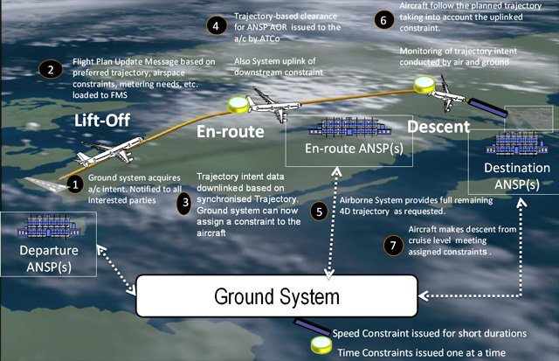
SESAR Concept of Operations - Trajectory Management

Slide 19
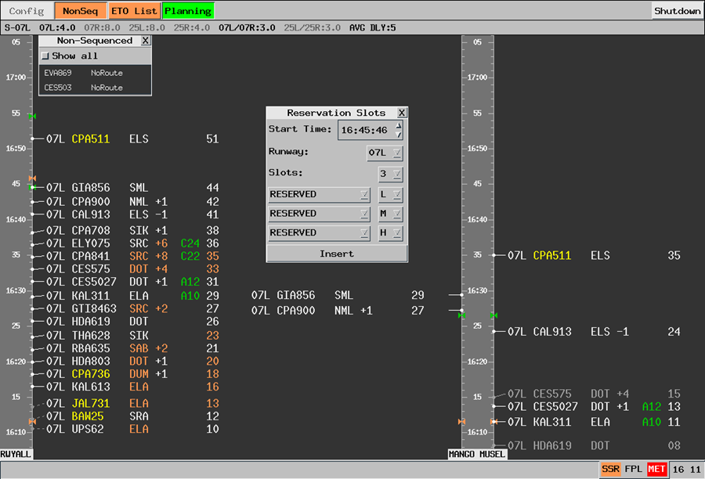
SESAR Concept of Operations -Automation Support
Automation for the routine controller task load supported by better methods of data input and data management.
Automation support to conflict/interaction detection, situation monitoring and conflict resolution.
A significant reduction in the need for controller tactical intervention, by (a) reducing the number of potential conflicts using a range of deconfliction methods, and (b) redistributing the tactical interventions to the pilots

Slide 20
SESAR Concept of Operations-New Separation Modes
Separation modes fall into three broad categories:
1. Conventional Modes: those that are essentially unchanged by SESAR.
2. New ANSP Separation Modes: new modes that are applied purely by ATC that involve Precision Trajectory Clearances (PTC).
3. New Airborne Separation Modes: new modes that involve the aircraft and in which the pilot is the separator either by delegation or as the standard case.
Precision Trajectory Clearances (PTC) can either be on 2D routes (with lateral containment), on 3D routes (with lateral and vertical containment), through trajectory control by ground based speed adjustments, or through 4D contracts which prescribe the containment of the trajectory in all 4 dimensions for the period of the contract. The purpose of each of these is to reduce substantially the uncertainty of the predicted aircraft position and thus reduce the number of potential conflicts/interactions that need to be resolved by the controller.

Slide 21
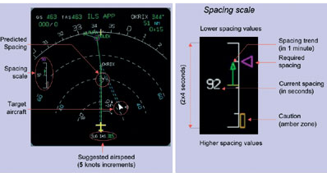
SESAR Concept of Operations-New Separation Modes
New Airborne Separation Modes use airborne systems to allow spacing and separation tasks to be delegated to the pilots. Three basic stages are envisaged;
(i) pilots are required to identify a specified aircraft and maintain the designated spacing from it,
(ii) pilots are required to identify a specified aircraft and to separate themselves from it, and
(iii) pilots accept responsibility to self separate from all other aircraft in the vicinity. The periods and circumstances of such delegations will need to be clearly defined.

Slide 22
SESAR Concept of Operations -ATM Capability Levels
Four different levels of ATM capabilities are defined.
To support collaborative decision making:
Trajectory sharing air/ground and ground/ground
Collaborative delay management applications.
Increased airspace-user/service-provider datalink capabilities
Meteorological data sharing.
To support management by trajectory (including queue management and separation):
CTA/CTO management
Functions related to Situational Awareness and Spacing/Sequencing and Merging
Conformance monitoring
Self-Separation functions

Slide 23
SESAR Concept of Operations-Airports
Airports are fully integrated into the ATM network as nodes in the system. CDM will be used to ensure a seamless process over the entire planning spectrum, and will be used between airspace users, ANSPs and airports (using arrival, departure and surface management tools) to assist queue management so as to make best use of all available runway capacity.
Runway throughput will be enhanced by reducing occupancy times, reducing arrival and departure spacing, wake vortex prediction systems and improved surface movement guidance systems.
Safety will be enhanced by using cockpit displays giving complete situational awareness on and in the vicinity of the airports surface and allowing warnings to be provided directly to the flight crew rather than through the intermediary of a controller.
It is expected that the combination of Trajectory Management, Airborne Spacing tools and precision navigation techniques will reduce air and ground holding and enable Continuous Descent Approaches thus leading to reduced noise and environmental emissions.

Slide 24
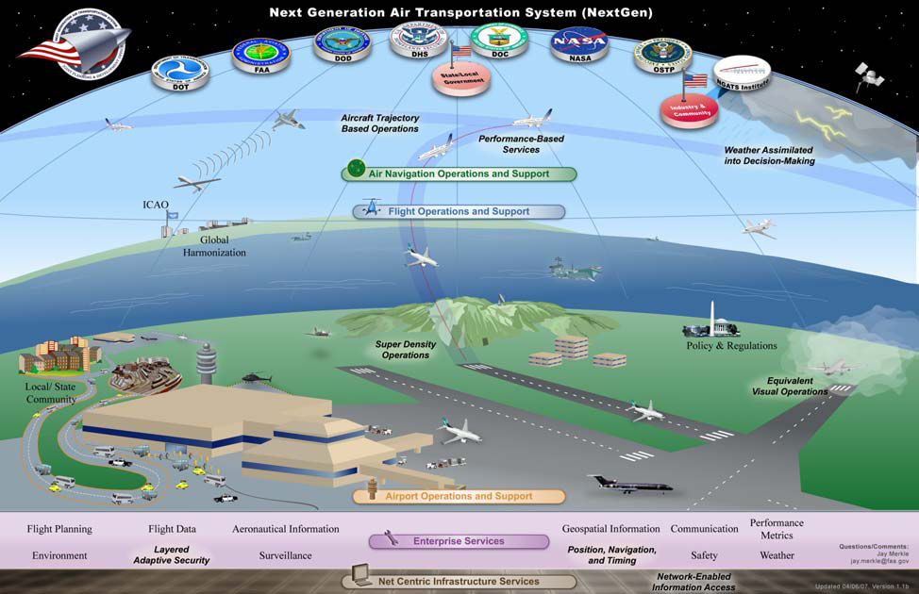
NEXTGEN

Slide 25
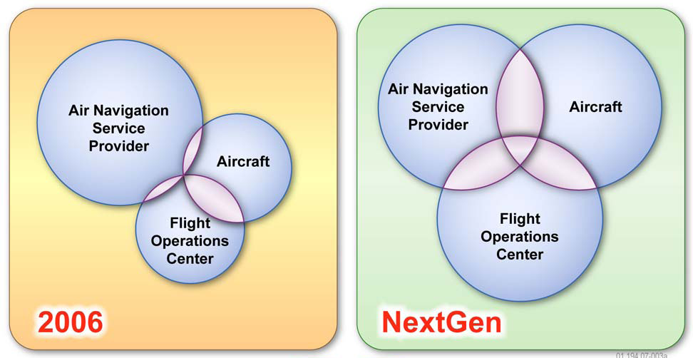
NEXTGEN - CHANGES IN ROLES AND RESPONSIBILITIES

Slide 26
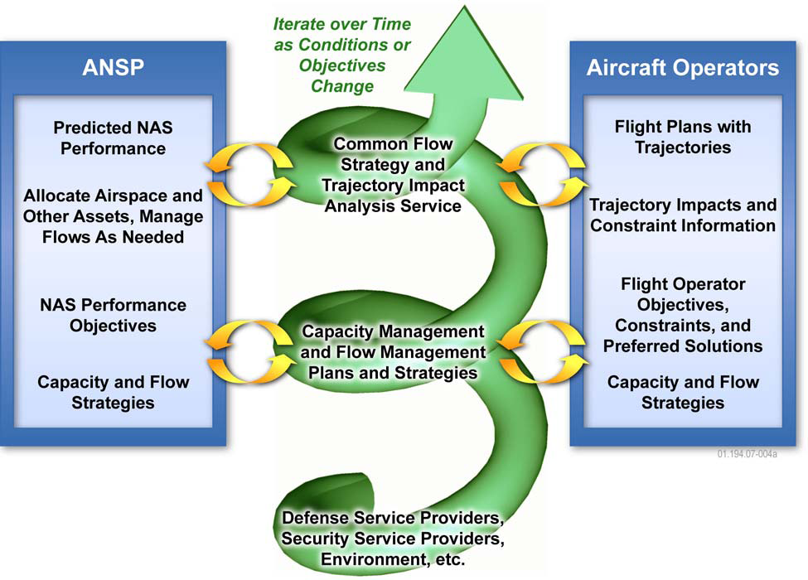
NEXTGEN - Collaborative Air Traffic Management

Slide 27
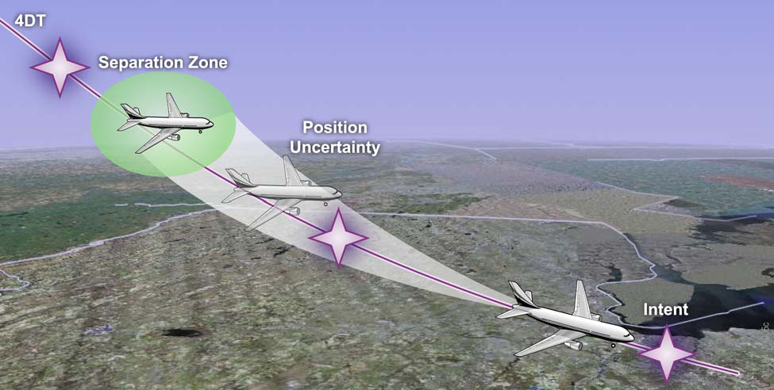
NEXTGEN – TRAJECTORY-BASED AIRSPACE AND OPERATIONS

Slide 28
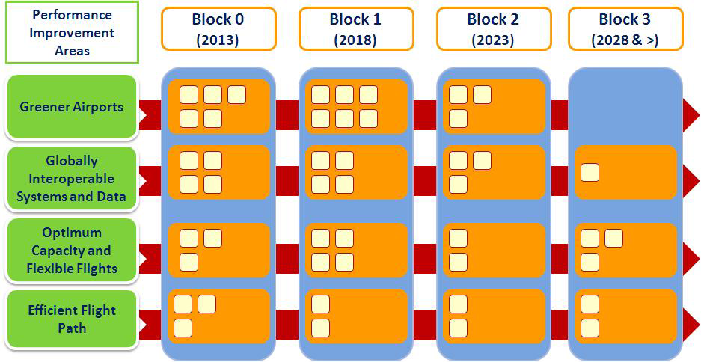
ICAO Aviation System Block Upgrades

Slide 29
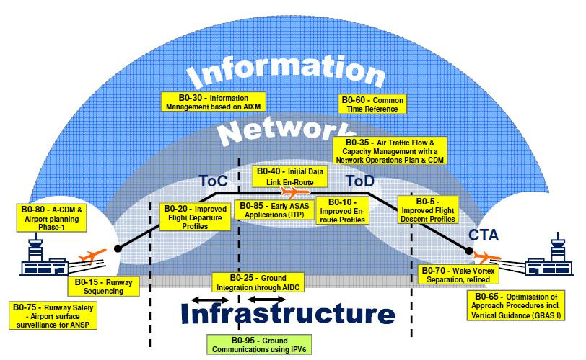
ICAO Aviation System Block Upgrades

Slide 30
ICAO Aviation System Block Upgrades
Summary Table of Aviation System Block Upgrades Mapped to Performance Improvement Areas

